Slide 1
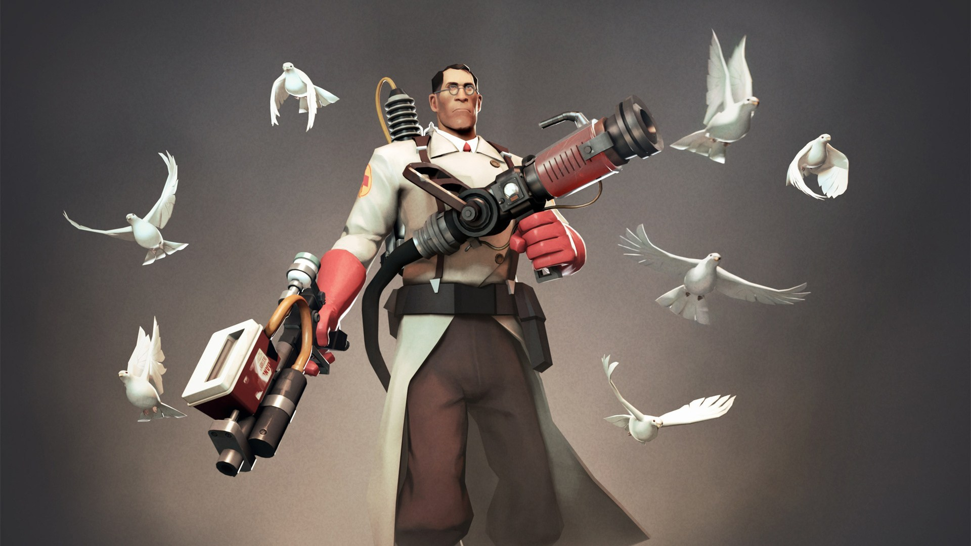
Battleships

Slide 2
Design: overview
The premise of my program, rules, and functionality
Scope
What I should be able to achieve within the time period and basic functionality that needs to be met.
UI
Design of the User Interface with a description on design choices
Idea

Slide 3
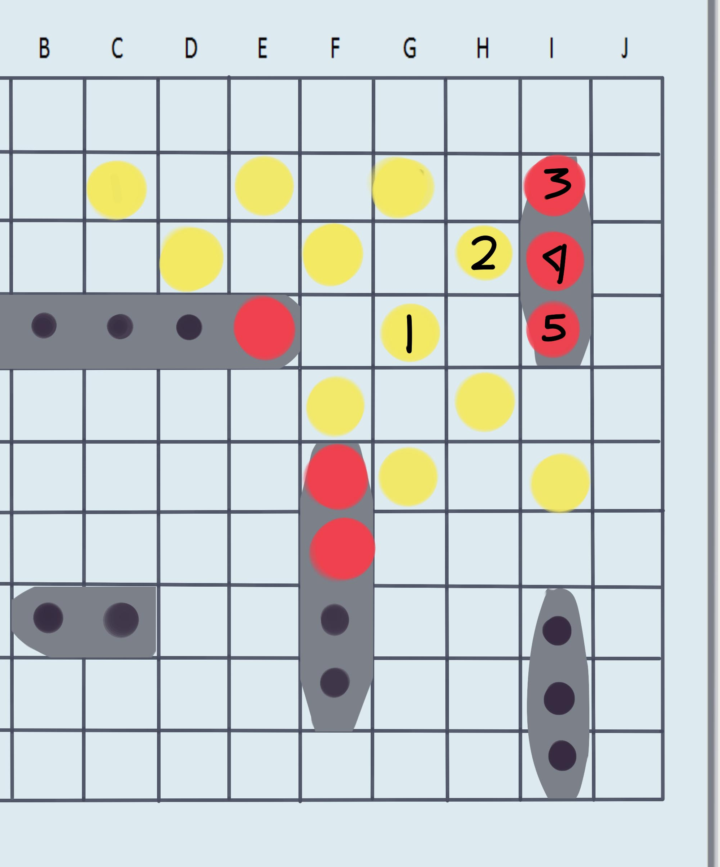
Idea
Missed shot
Hit shot
For my Something Awesome Project (SAP) I set out to create a battleship game. The rules of battleship are the following:
1. The game is be played on a 10x10 grid.
2. Each competitor will place each of 5 ships (of lengths 2, 3, 3, 4, 5) on their grid.
3. No ships may overlap, but they may be adjacent.
4. The competitors then take turns firing single shots at their opponent.
5. The opponent will notify the competitor if the shot sinks, hits, or misses.
6. Game play ends when all of the ships of any one player are sunk
In rules required to make the game functional are 1,2,4,5,6. 3 is something that can trusted to the User to follow.

Slide 4
Scope
Constraint:
Time: 3 weeks to work (assuming I don’t procrastinate and stray away from reality) .
Time was the only main constraint for this task, there are three versions of battleship I can make:
1. User 1 vs User 2 (simplest version, simply 2 players on the same device, trusting both users don’t cheat by looking at the others side of screen).
2. User vs Computer ( User versus random generation or an algorithm to fire).
3. User vs Ai (User versus a simple version of Artificial intelligence)
Due to the constraint of time I will probably settle for User vs Computer. This is because Number 3 requires me to learn how make an AI, learn basic ML (machine learning), and how to implement to bot into my project. All of this while developing the rules for the basic game. Number 1 seems too simple and requires a lot of User trust. So number 2 seems just right.

Slide 5
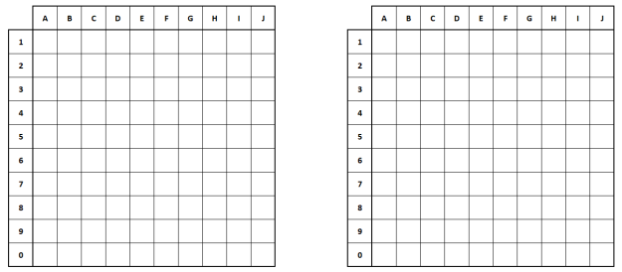
UI
(2) Enemy grid
(1) User grid
Ships are placed on the User grid, using the ship option buttons to select the type of ship and the orientation of the ship. Once this is done the user selects the “Save Board” button. Once clicked the user is not allowed to adapt the board, the only option is to commence attack. Once the attack commenced the Enemy grid becomes clickable and the user clicks the board to select a position on the board to guess.
Forfeit
Save Board
Carrier
Battleship
Submarine
Cruiser
Destroyer
Vertical
Horizontal
Begin Attack
Button for Alistair
Don’t allow for adaptations of the board
Button to commence the war
Ship options

Slide 6
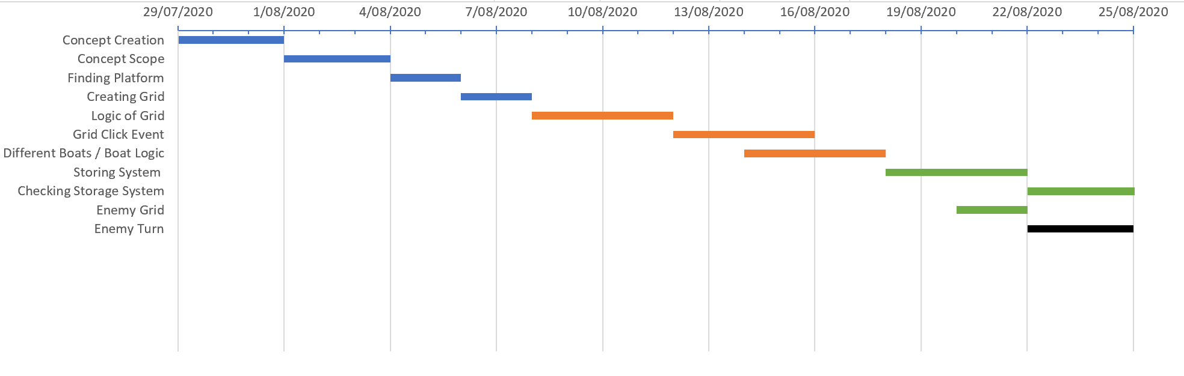
Gantt chart
1. Figuring out a concept for the project
2. Suiting the concept to the constraints
3. Finding a suitable platform/ language for the concept
4. Creating User Grid
5. Finding a way of calling cells
6. Finding a way to click cells to trigger event
7. adding all the boats of battleship
8. Way fo storing the current User grid layout
9. Way of checking the location of boats in the grid
10. Making enemy grid
11. Adding the enemies guess and verifying results.

Slide 7
Documentation: Overview
Main functions of my code
Explanation
What I should be able to achieve within the time period and basic functionality that needs to be met.
Style Guide
How well my code COMPLIES with the style guide
Key Points

Slide 8
Key Points:
The key points are the functions needed for the game to work. Not talking specific, but the broad functions that must take place, in one form or another
Method of:
Generating grid – HTML Table
Placing specific ships – Button usage
Clicking grid cells – Click events
Storing where ships are - Arrays
Saving grid and starting game – Remove click events, start game button
Taking turns with computer – call EnemyTurn function

Slide 9
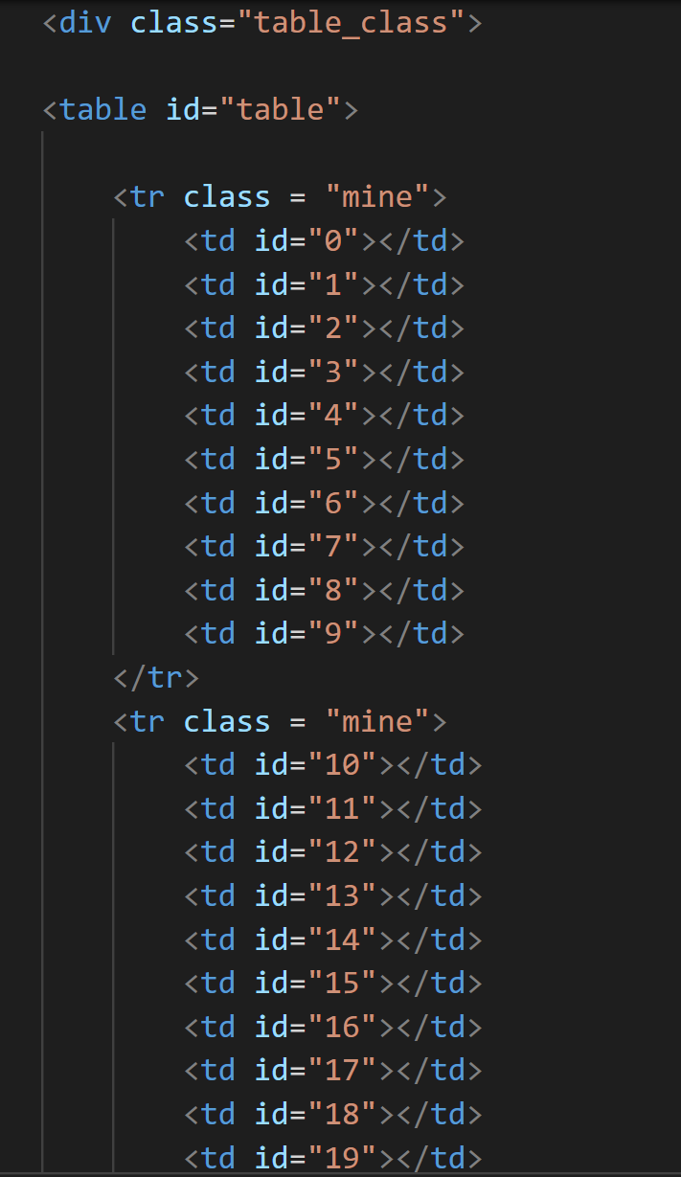
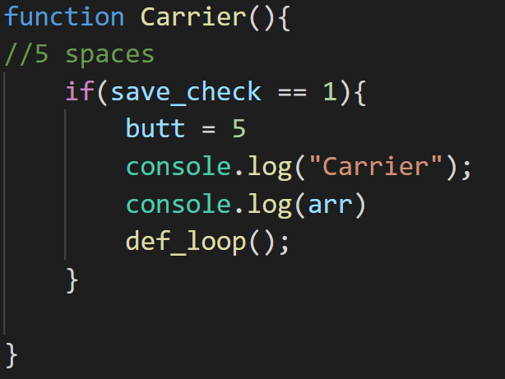
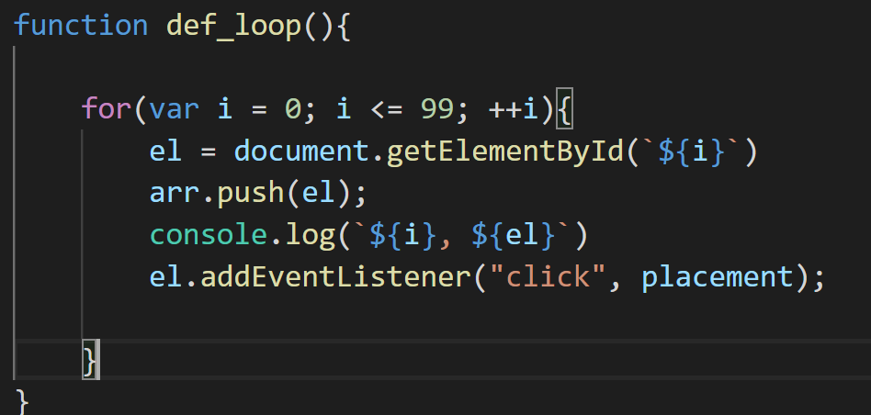
Details of 1-3 Key Points
Grid
The grids for both enemy and User were created using tables in HTML. For the grid there needs to be a way to identify individual cells in the table. For this I added ID’s to every cell.
Ships and orientation of ships will be chosen through buttons. This is a more simplistic approach compared to a drag feature, which would be hard to implement with click events. The playout of this: the user selects the ship with a button below, e.g. Carrier. Once clicked a variable name butt (FOR BUTTON) will set the spaces allocated for the ship, e.g. for carrier its 5 spaces. Butt = 5. To change orientation (vertical or horizontal) buttons called Horizontal and Vertical will be below the grids. If vertical is clicked a variable called place will equal one. Default is 0.
Ships
Clicking grid
To enable clicking on the grid I created a function called def_loop() that loops through the IDs and adds click events to every single one. Once a cell is clicked it calls upon a function called placement() (function named placement because it decides the placement of boats). This function first changes the value of an array that has the placement as the cell (an array that will be covered in Arrays), placement() also checks the orientation the boat being placed will be.

Slide 10
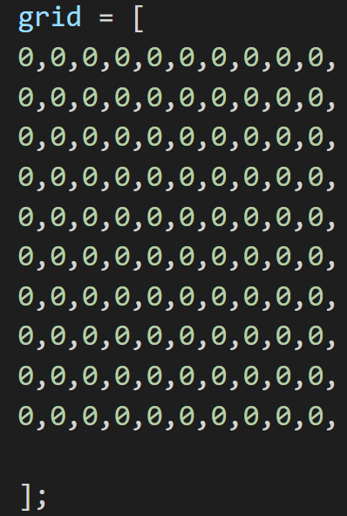
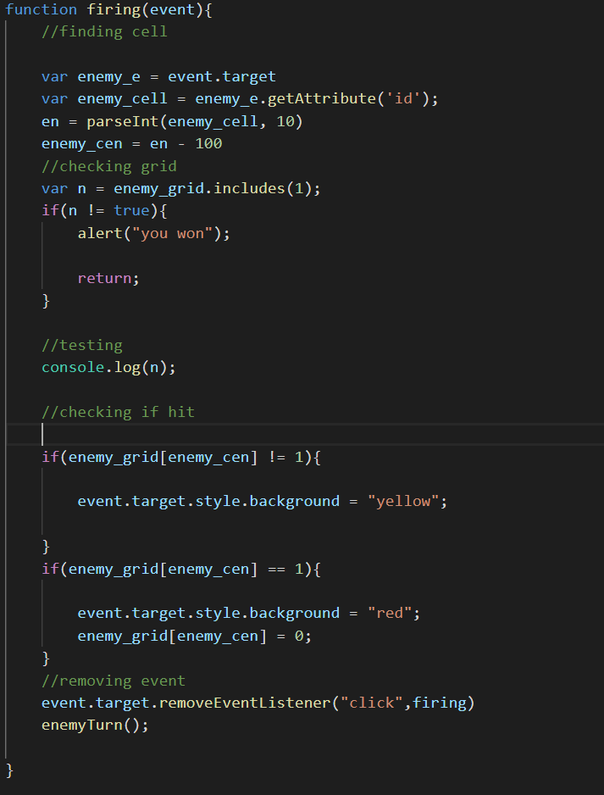
Details of 4-6 Key Points
To store the ships of both enemy and player arrays were used. In the array 0 symbolised a blank area(as usual), and 1 meant the cell was part of a ship. When a ship was selected, direction was selected, and a click was made the id of the target cell would be identified, converted to an int and that number in the array would be converted from a 0 to a 1. Then, if the ship direction would be checked. If horizontal a loop, looping from 0 to the length of ship (butt variable), would first get the ID of the next cell along ( +i) and change the colour of selected cell. Then find place in the array and amend the 0 to a 1. If vertical the process would be repeated, but to get the cell beneath the original cell + i would need to be times by 10.
For the Enemy the storing process is the same, although there is no User input for obvious reasons, and when clicked by user the selected number in the array’s value is changed from 1 to 0. removing the value.
Storing Ships
Saving/Starting
To save the current grid there is a button, once clicked all of the click events are removed from the cells to insure there is no meddling with the board. To begin the game there another button, once clicked it adds the click events to the enemy board, so user begin to guess on the board.
Once the user clicks on a cell with an eventlistener the function ‘Firing’ is called. Firing; as said in Storing Ships; checks to see is if the cell clicked has a ship section on it. This done with array storing the grid. 1 for ship, 0 for blank space. Variable n checks to see if a ship still remains on the enemies grid, if false the player wins. Once the click and check is made the eventlistener is removed from the click cell, then enemy turn is called. Enemy Turn first randomly generates a number then makes sure the chosen number hasn’t already been used. Then it checks to see is the selected number (the grid cell aswell) has a ship on it (1 or 0) if so then colour changes to red and the 1 is amended to a 0.
Turns

Slide 11
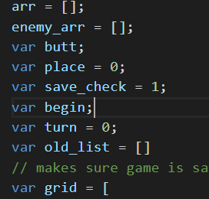
STYLE Guide
I believe my code follows the style guide like a loose religion. All of the global variables are clearly labelled for there purpose and variables with multiple words have an underscore. Although I when originally making the game, I sometimes forgot about the style guide and made some terrible variables. Style guide is a work in progress.

Slide 12
Evaluations: Overview
How I could have managed myself better
Improvements
Self Evaluation
How I could improve my code

Slide 13
Self Evaluation
what I set out to do and the initial requirements I set out for this project were achieved. Originally I set out to make a Battleship game with the simple rules of:
1. The game is be played on a 10x10 grid.
2. Each competitor will place each of 5 ships (of lengths 2, 3, 3, 4, 5) on their grid.
3. No ships may overlap, but they may be adjacent.
4. The competitors then take turns firing single shots at their opponent.
5. The opponent will notify the competitor if the shot sinks, hits, or misses.
6. Game play ends when all of the ships of any one player are sunk
All of these rules were handled apart for number 3 which is trusted to the user. I believe this project went successfully for me and proved beneficial to my understanding of coding. In order to complete this project I had to learn: ID’s and Tables from HTML, and JavaScript. My only experience with JavaScript prior to this assessment was the software development with canvas. Throughout the project I learnt how to problem solve and research a new language efficiently and overall gain more knowledge towards to subject.

Slide 14
Improvements
1. Enemy Turn: The enemy turn in its current state is only a random number generator. I pains me to say that I should have managed the first week of my time more efficiently and focused more on the overall idea of the game rather then spending a week learning HTML and IDs. I even left room for the hunt n kill algorithm to be implemented. This taught me a great lesson about time management and hwo I need to improve this before adventuring into the computer science jungle.
2. Looping the grid: This only annoys me because the gird takes up SOOOO manby lines and learning that you can loop through it pains me.
3. Style guide: something that I learnt from this project that will follow me for the rest of my coding career si that when coding ALWAYS think of the style guide when creating variables. I looked back after seeing the marking rubric in disgrace.

